Slide 1
Informatics Plan
NURN 300
Student Name
Course Date

Slide 2
Assessment
The use of evidence based practice is useful in ensuring good patient outcome. This is done through
personal health record and telehealth
Effectiveness of personal health records and use of technology.
Challenges accrued to establishing personal health records
The impact to health care and quality of service provide
Possible mitigation plans and implementations to effect the personal health record
Notes:
The personal health record is essential to ensure effective treatment by sharing patient information when the need arises. The process involves integrating technology into health care to capture patient data, medication, and previous treatment. The electronic personal health record has changed the dynamics of health by increasing patient information access to aid in quick decision-making on patient health. Technology is equally involved in helping in the diagnosis of various conditions. Such technology includes the use of a virtual stethoscope and thermometer to better the diagnosis process. The multiple challenges attributed to this process include high costs of installation, lack of awareness, security concerns, and inadequate government support. The impact of such systems on health is enormous, with a significant reduction of mortality and morbidity. It is essential to identify the challenges affecting this process and implementing the possible solution.

Slide 3
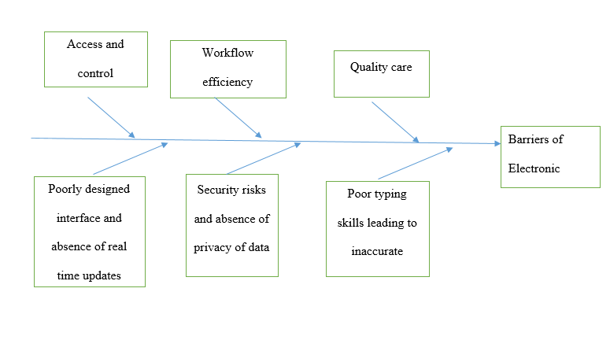
Cause and Effect Diagram
There are different barriers attributed to personal health records The inhibiting factor to personal health records includes: cost, security issues technological challenges to access use patient data. The patient records available in the system promotes Work efficiency and quality of health care Most patients finds it hard to remember all the medication and procedures done.
Notes:
The various barriers attributed to personal health records and telehealth involve the system's poor design with an absence of real-time data following lack of capital for updates and a specific approach to meet the population's needs. Incorrect data in the system often occur at the point of input following poor typing skills and inability to interact with the system correctly. Security concerns of the data are equal contributors in keeping patients resistant from adopting the new scheme. Following numerous cybersecurity cases, most patients are reluctant and health facilities equally avoid being held accountable for any leaks on patient records.

Slide 4
Barriers Identified
1.Poor design interface and absence of real time data
2. Poor typing skills leading to inaccurate data
3. Security concerns and absence of data security
Notes:
The barriers to effective use of technology in health and adoption of personal health records range from inadequate funding to individual attributes. Among the critical hindrance are the considerable cost involved in setting up and purchasing electronic devices necessary for data entry and diagnosis. It is costly to design a system that is accepted worldwide for effective patient treatment. Other challenges include a lack of adequate knowledge on existing technology with their importance to health. Also, most people have developed a fear of using current technology due to frequent cyber-attacks on data that is supposed to be confidential. Lastly, the inadequate skills of operating the systems influence the data obtained or recorded in the system.

Slide 5
Planning- Poor design interface and absence of real time data
Controlling the access of information and restricting user access to individual with credentials
Frequent update of the system to provide real time data
Focus on design to meet the health care need and the necessary expectation of the population such as language and attributes most affected by the population
Provide alternative backup plans of the networks and ensure they are secure
Notes:
The majority of the challenges attributed to inadequate integration of personal health records and telehealth are the system's design. Most systems are not designed according to user specifications, such as language and efficiency of using the system. The system deployed should be acceptable by the community and possess features of altering the information to enable updates in creating real-time data. Linking the techniques to different parts of the country by providing uniformity is the primary attribute of real-time data. Establishing such systems requires a backup plan for the data and all information concerning the patient.

Slide 6
Implementation
All the patient records are to be uploaded to the system by a trained qualified person and reduce the chances of redundancy
System management to ensure the use of current technology that is theft free and user friendly.
Identify form of feedback from the patients and work on them to improve service provided
Creating awareness on the benefits of using the programs and costs of establishing working system be supplemented by the government
Notes:
Following a precise analysis, noted majority of challenges originate from the input of information and during manipulation when adding new patient information. The intake of patient information ought to be assigned to specific individuals with adequate skills and training. The system being used equally has to be of current technology to note any repetition and attacks on the approach to offer to warn or alert the relevant authority. To establish a working system, the cost of implementing and initiating the program needs to be allocated in the budget and maintenance. Create awareness to the public and other health workers on the importance of using technology and personal health records

Slide 7
Planning -Poor typing skills leading to inaccurate data
Data input strictly designed to meet the patient needs and health care workers level of understanding
The language in the programs to meet the user understanding and ability to interpret the information
Providing education and training on the computer use and the process involved in imputing data into the system to ensure accurate information is used in the system
Notes:
Most electronic devices operate on input manually entered. The majority of patient data are raw data that require physical input into the system. The keyboard is most often used to enter such information into the system and may come with different designs or language encryptions. Most of the challenges in data occur at this point with people who are not trained on entering data and other programs used for data analysis. Providing user preference keyboard and education with training on data input is critical to reducing such errors

Slide 8
Implementation
Establishing training schools and seminars for health workers involved in record keeping to boost their skills in data entry, management and retrieval.
Ensure the feature and software used in the data entry and storage are user friendly and can easily be manipulated to meet the patient needs
Only authorized personnel are to enter, retriever and alter the patient data
Encourage maximum honest from the patient on their information to reduce double records and false records within the system
Establish a unique code of identifying each patient as they may have similar names causing confusion and false records impairing treatment process
Notes:
It’s a knowledge-based challenge; hence, most people ought to undergo training on data entry as a necessity of working at this section. Making it mandatory for all health workers to learn the skills and ensure only authorized personnel are allowed to access, retrieve and alter the information. such practices are only feasible when we make a rule for every school to provide training and each patient is recorded in the system to have a unique identification code
.

Slide 9
Planning- Security concerns and absence of data security
Patient information is often private and confidential and such records should strictly be kept in that format
The process of ensuring security for the information starts with the provision of good system, knowledge and extra security check on the data
The biggest threat is cyber security, ensure all the information are protected by the use of firewalls, passwords and computer systems kept free from malware.
Person access to patient data restricted to a few members with a clearance level or security code of access
Notes:
Security is one of the biggest challenges facing personal health records. Several cyber crimes have negatively influenced the scheme's adaptation as most patients don't like their consultation being known publicly, or some may be used against them. Such information ought to be patient-doctor confidentiality. Electronic communication has the most significant potential of being altered, destroyed, or used for destructive purposes. Therefore, it is essential to provide effective means of protecting patient Information from unauthorized personnel by using passwords and firewalls. It is equally important to limit the number of people with access to information to be accountable and maintain confidentiality.

Slide 10
Implementation
Use of updated security protocol on patient data.
Restrict access on patient data to a limited number of people with credentials
Ensure patient information is protected with passwords and other security features
Establish awareness on cyber crimes, the importance of protecting patient information and setting up funds aside for system updates
Separate the information gathering point from other work entities to limit any form of destruction or altering of the records in addition to providing enough security for the data
Notes:
The possible mitigation strategies include setting up effective systems with impenetrable firewalls and security checks. Limiting the number of users with access to patient information to two apart from the patient and ensuring the available information is password protected. Awareness is equally essential to increase the alertness of any attempts of cyberattacks. When designing an information room, ensure it is set aside from the main operation centers to restrict the number of people visiting the site hence reduce the chances of the destruction of information.

Slide 11
Evaluation
The most significant barrier attribute to personal health system are cost involved in the implementation and lack of awareness on the benefit over disadvantages.
It is essential to adapt a personal health record to ensure accurate and quality services from the health care
Through implementation of the proposed guidelines on security and errors the trust of the population to adapt a personal health record has increased facilitating adequate and accountable treatment.
Notes:
By applying the proposed implementation, people's willingness to adapt the personal health record is likely to increase. More health care workers are moving to new technology in diagnosing patients and taking vitals. The patient health concerns are quickly managed, and possible intervention meets the following information available when the need arises. Due to such interventions, the quality of health is improved, and mortality has decreased massively

